Slide 1
Evolution
Raw material

Slide 2
Darwin’s blind spot
How does heritable variation in phenotypic traits arise?
How exactly are traits passed on from one generation to the next?
Phenotypic variation
Selection
Fitness

Slide 3
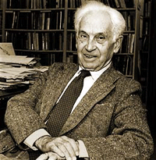
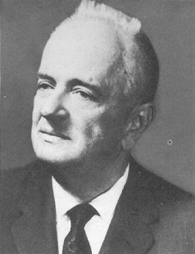
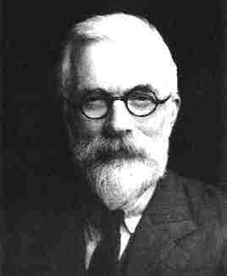
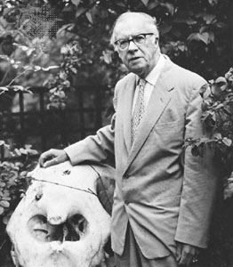
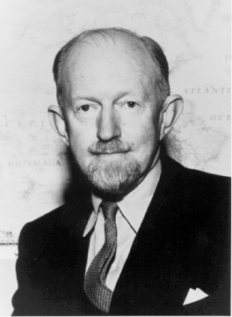
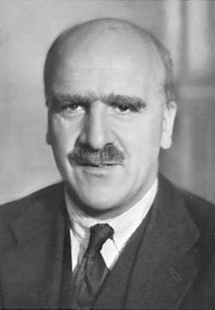
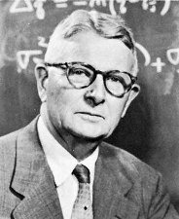
Evolutionary theory after Darwin
Integrating evolutionary theory with genetics and population genetics
Modern synthesis between 1936-1947 by E. Mayr, R. A. Fisher, T. Dobzahansky, J. B. S. Haldane, S. Wright, G. G. Simpson, and J. Huxley

Slide 4
A modern view of evolution
Disentangling the links between genotypes, phenotypes, and fitness
Acknowledging the effects of other evolutionary mechanisms
Genomic variation
Genetic drift
Development
Phenotypic variation
Migration
Mutation
Selection
Fitness

Slide 5
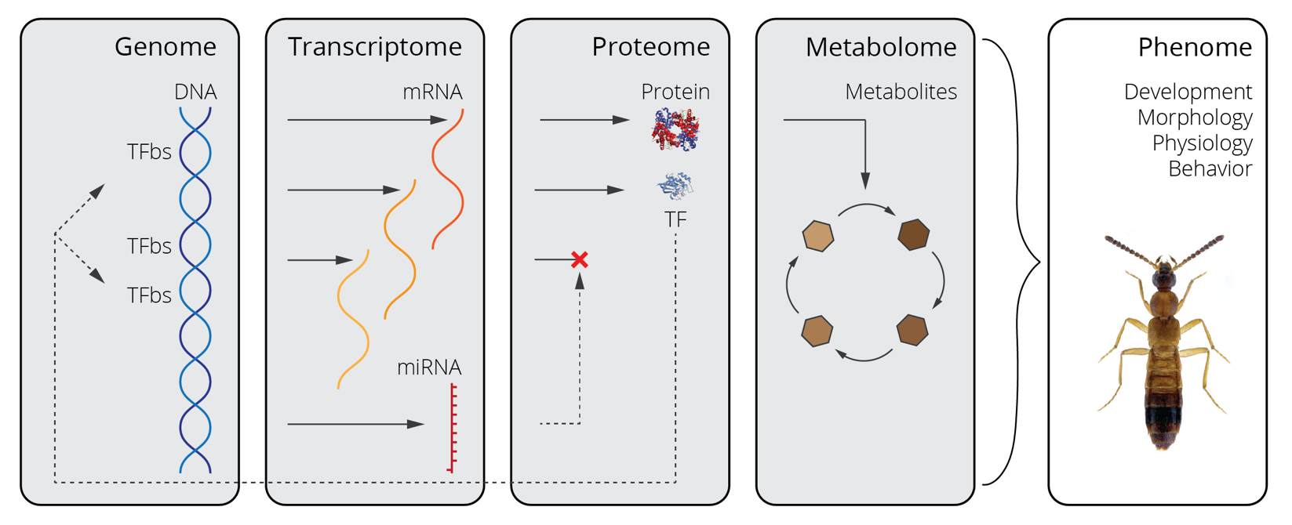
From genotype to phenotype
Notes:
Testing a priori hypotheses across levels of organization.

Slide 6
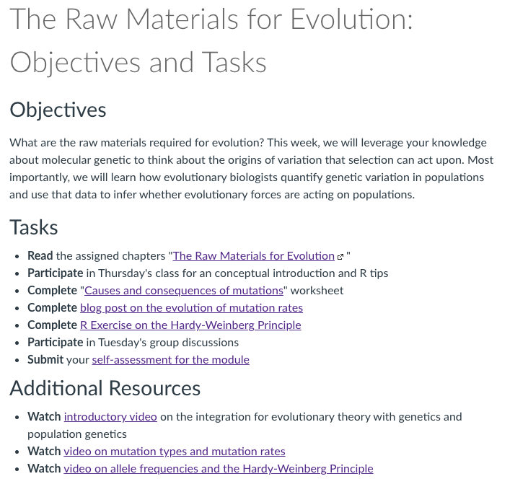
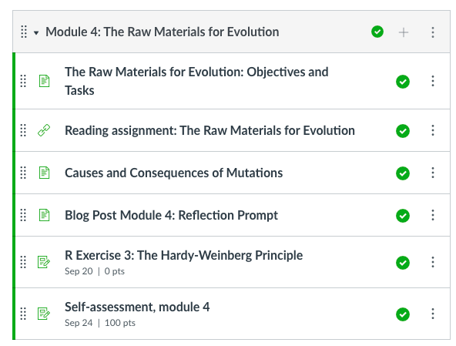
Module 4
Notes:
Testing a priori hypotheses across levels of organization.

Slide 7
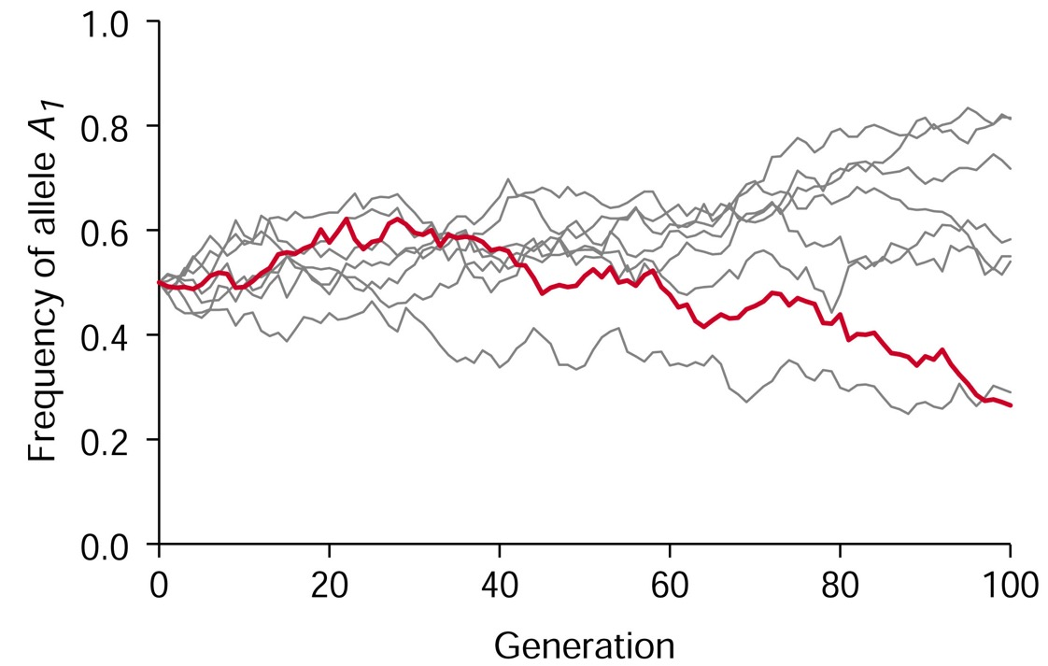
Evolutionary theory after Darwin: a genetic view
Evolution as change in heritable traits across generations
Versus
Evolution as change in allele frequencies across generations

Slide 8
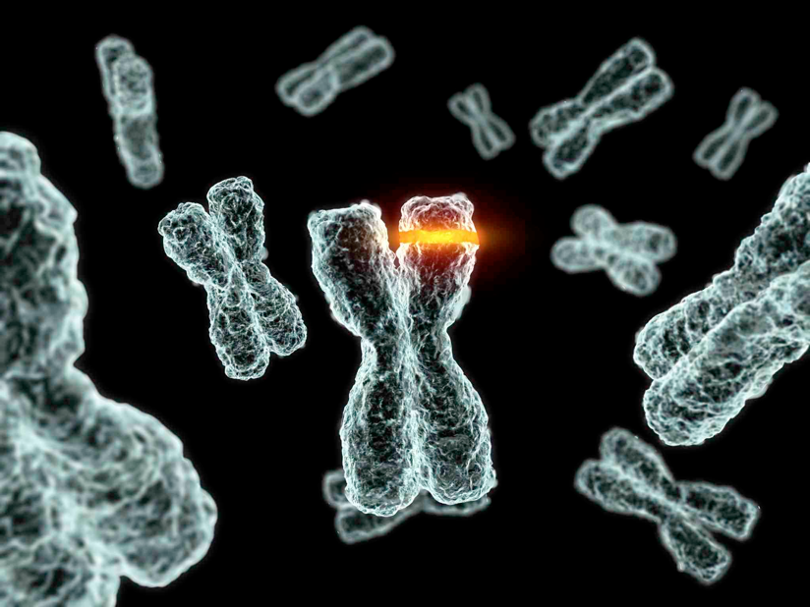
Mutation provides the raw material for evolution
Change in the nucleotide sequence in the genome
Ultimate source of genetic variation
Responsible for new alleles
Responsible for new genes (loci)
Responsible for changes in gene regulation

Slide 9
Different types of mutation and their effect on evolution
Point mutations in protein-coding regions
Synonymous mutations
Non-synonymous mutations
Indels
Point mutations in non-coding regions
Mutations in junk DNA
Mutations in cis-regulatory elements
Gene duplication
Chromosomal inversions
Genome duplications

Slide 10
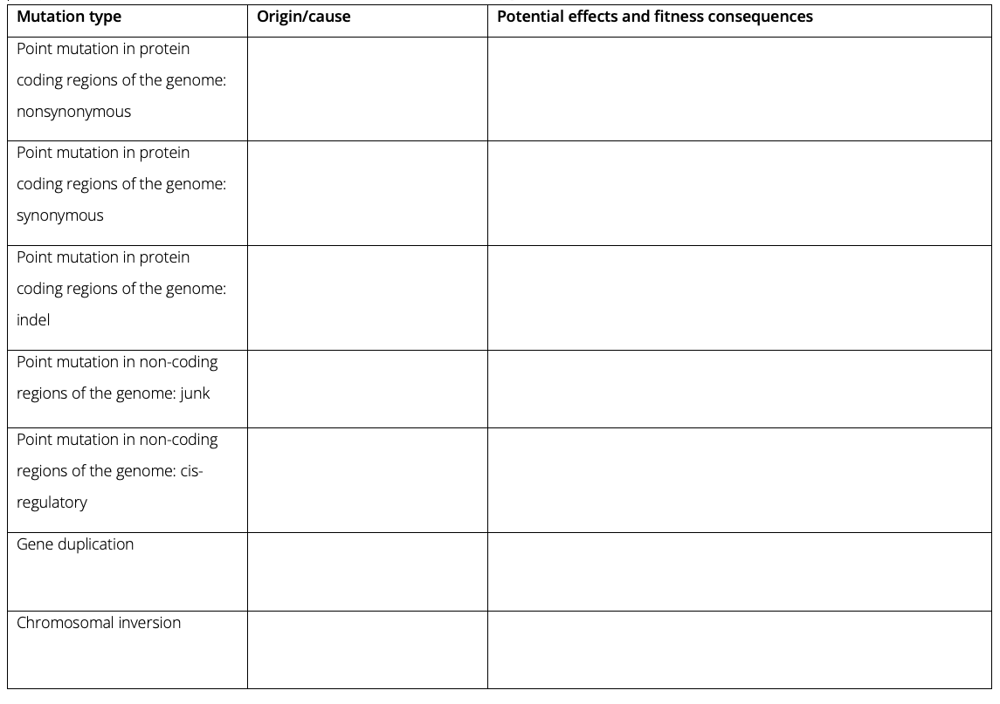
Different types of mutation and their effect on evolution
Origin/cause
What happens at a molecular level?
Describe how exactly a particular mutation type arises!
Potential effects and fitness consequences
How can a potential mutation type impact the fitness of a carrier?
Describe the various ways a particular mutation type can affect the function and fitness of an organism

Slide 11
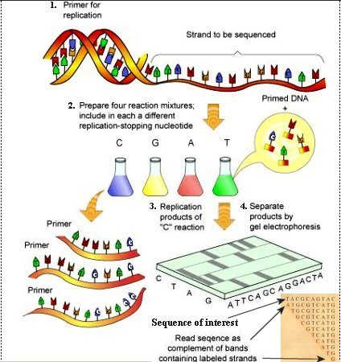
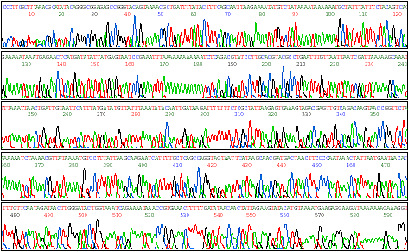
Quantifying genetic variation
DNA sequencing allows us to decode the DNA sequence of any given gene or whole genomes
For evolutionary studies, scientists often sequence many individuals of a population

Slide 12
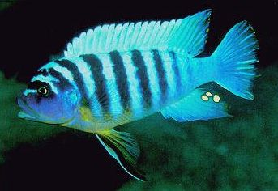
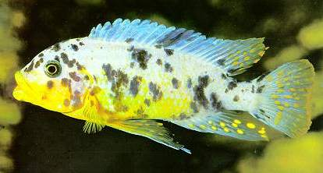
Calculating allele frequencies
Color polymorphism in African cichlids is based on a single gene with two alleles (A & a)
OB morphs are homozygous for the recessive allele a
In a population of 120 normal (80 homozygous, 40 heterozygous) and 80 OB individuals, what are the allele frequencies of A and a?
OB
Normal

Slide 13
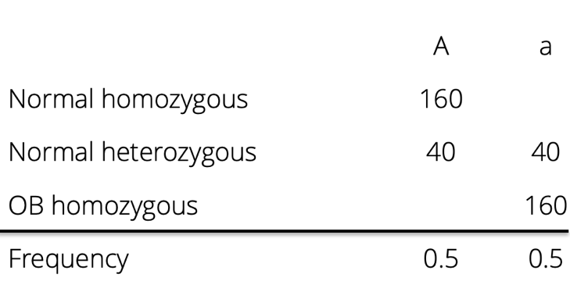
Calculating allele frequencies
Color polymorphism in African cichlids is based on a single gene with two alleles (A & a)
OB morphs are homozygous for the recessive allele a
In a population of 120 normal (80 homozygous, 40 heterozygous) and 80 OB individuals, what are the allele frequencies of A and a?
OB
Normal

Slide 14
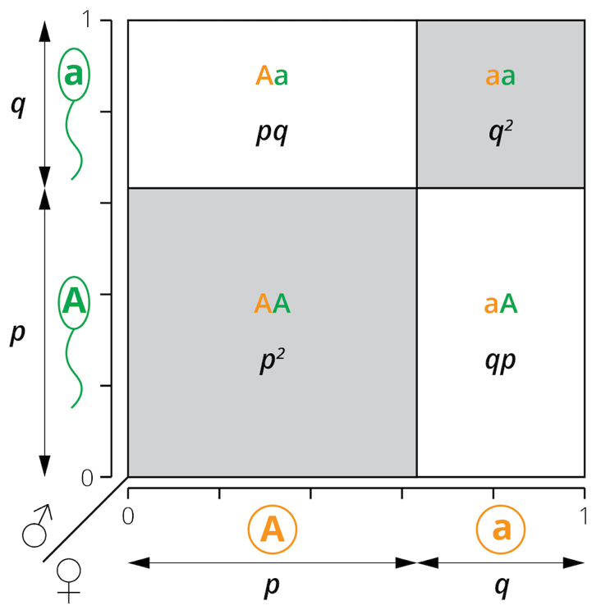
Allele and genotype frequencies across time
Hardy-Weinberg principle
In absence of evolutionary forces, allele frequencies remain constant from one generation to the next
In absence of evolutionary forces, we can predict genotype frequencies from allele frequencies within populations
Given allele frequencies p and q, genotype frequencies will be p², 2pq, and q²

Slide 15
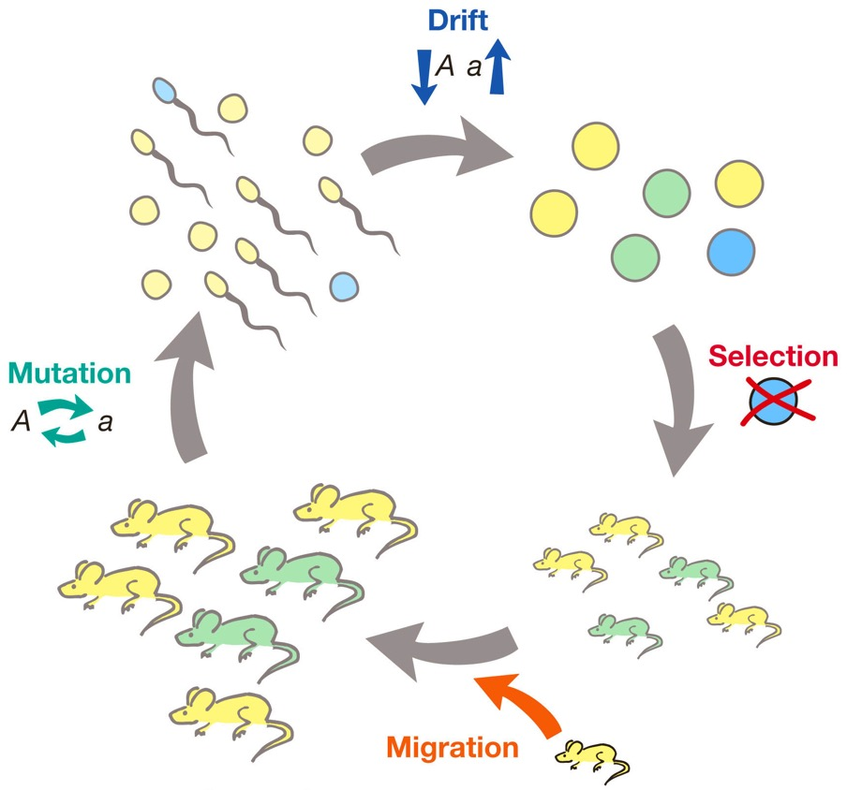
What constitutes an evolutionary force?
Selection
Mutation
Genetic drift (changes due to chance)
Migration
(Non-random mating)

Slide 16
The power of a null model
If the prediction of the null model is not fulfilled, some assumption of the model must be violated
Prediction
Genotype frequencies can be predicted from allele frequencies
Assumption
No evolutionary forces are acting
Measure genotype frequencies
Calculate allele frequencies
Calculate predicted genotype frequencies of idealized population
Idealized freq. = observed freq.
Idealized freq. ≠ observed freq.
HW Equilibrium
HW Disequilibrium

Slide 17
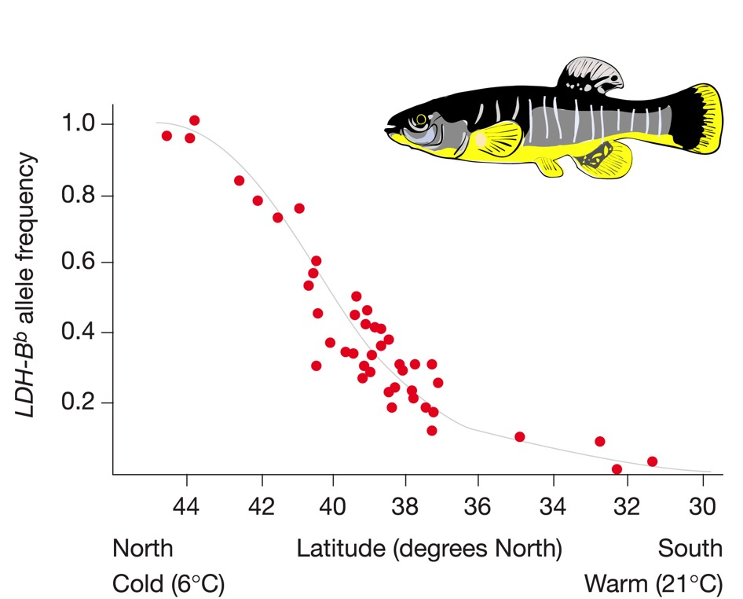
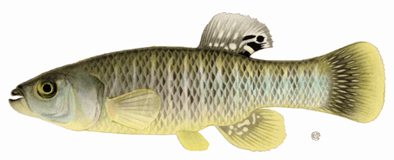
Genetic variation is ubiquitous
Genetic variation along environmental gradients
Temperature-dependent alleles in mummichog

Slide 18
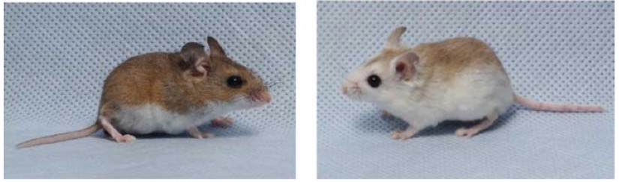
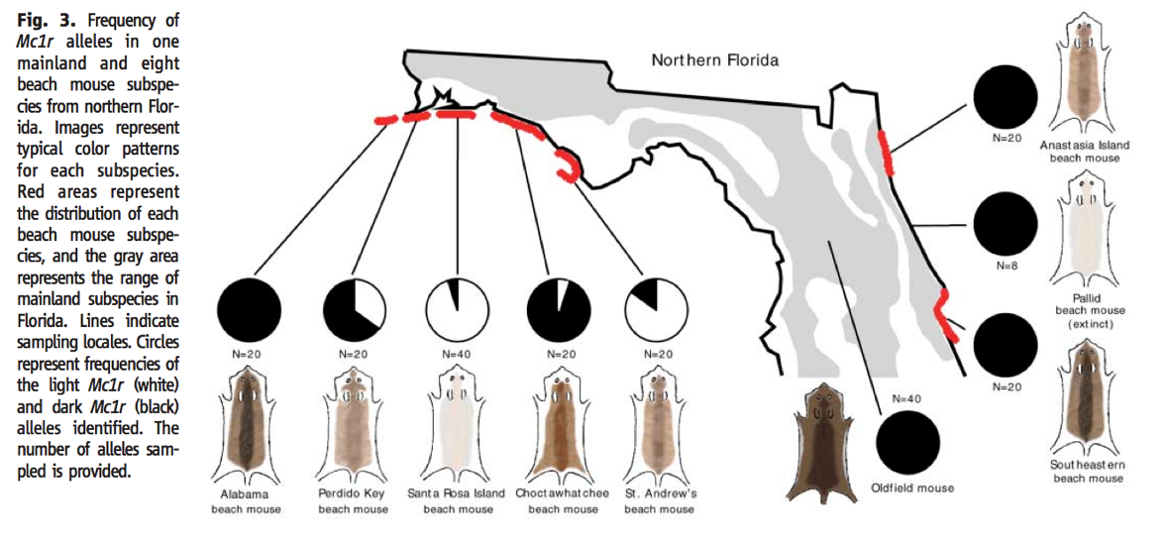
Genetic variation is ubiquitous
Genetic variation along environmental gradients
Temperature-dependent alleles in mummichog
Color genes in beach mice

Slide 19
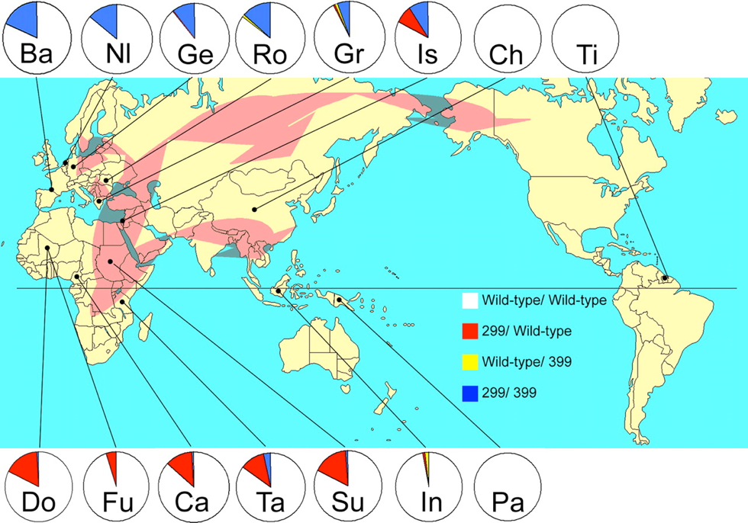
Genetic variation is ubiquitous
Genetic variation along environmental gradients
Temperature-dependent alleles in mummichog
Color genes in beach mice
Immune-related genes in humans

